Slide 1
TRANSCRIPT VIEWING

Slide 2
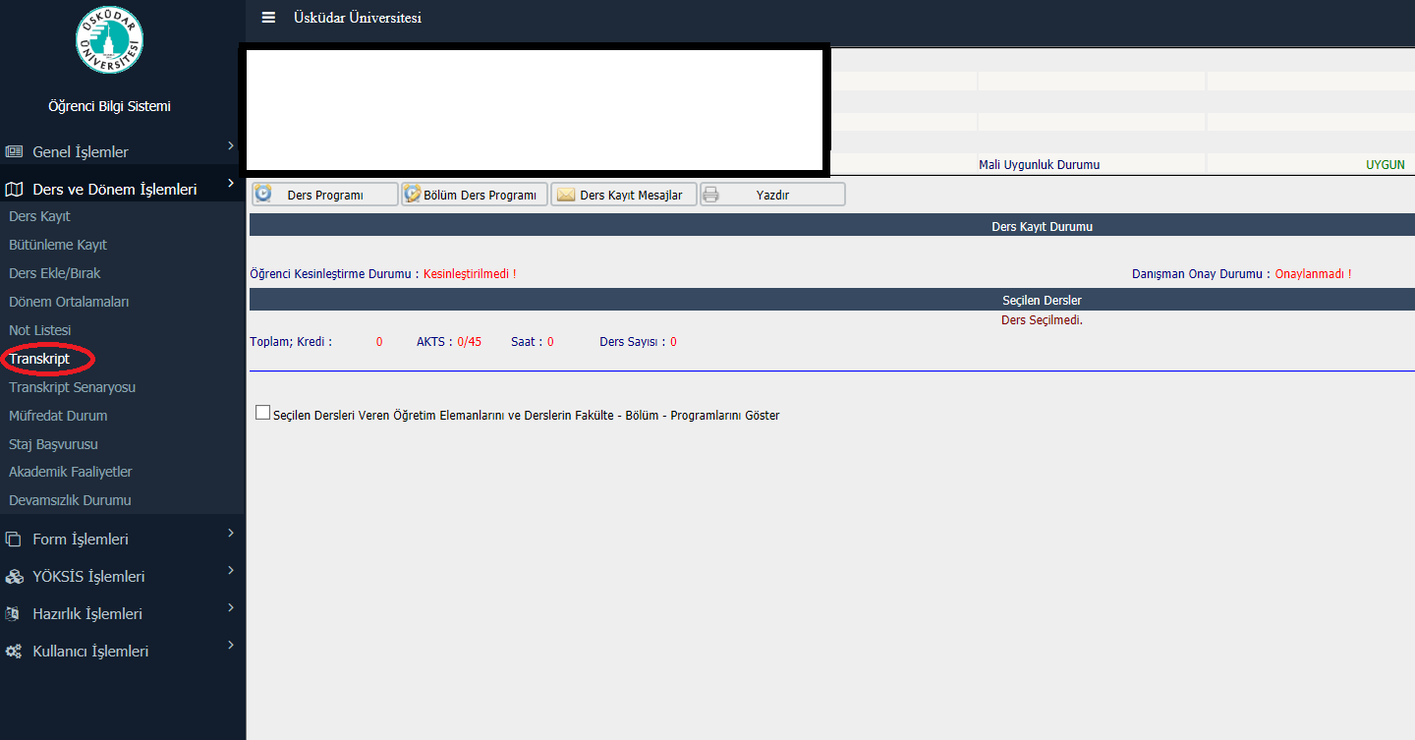
You can double-click the attached tab and view your transcript.

Slide 3
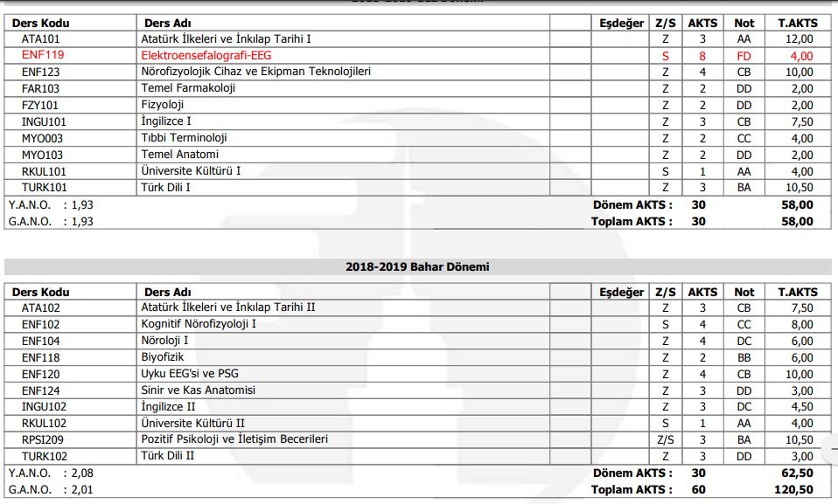

Slide 4
THANKS!

