Slide 1
HOW TO CHOOSE A COURSE?

Slide 2
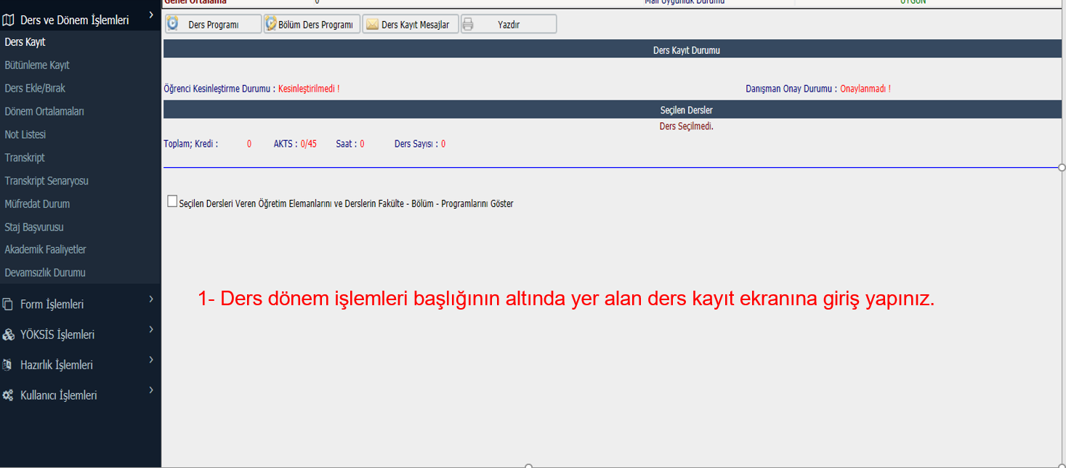
1- Login to the course registration screen at the bottom of the course semester procedures.
1- Ders dönem işlemleri başlığının altında yer alan ders kayıt ekranına giriş yapınız.

Slide 3
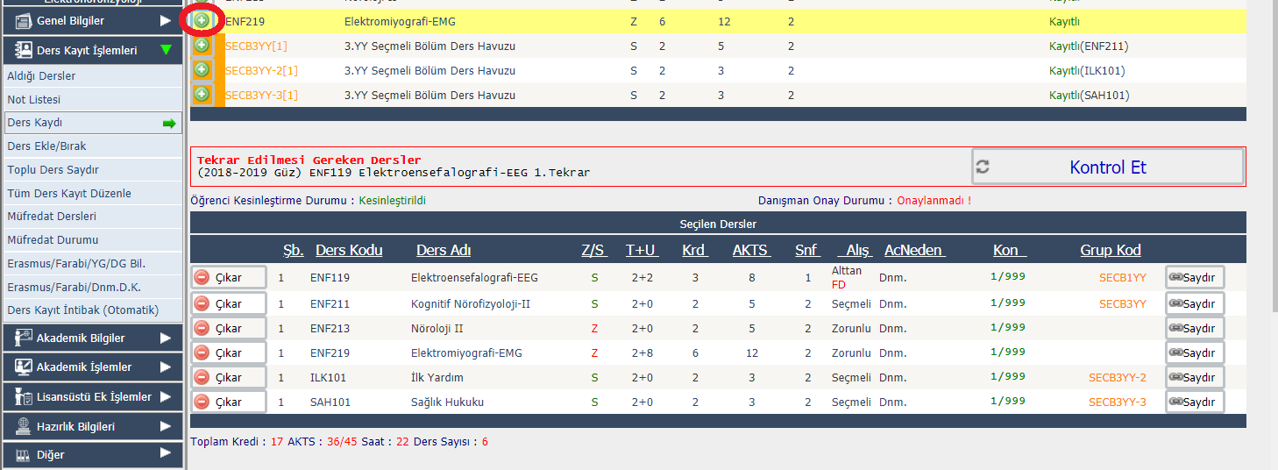
2-Click the green plus button on the left side of the lessons and select the course from the pop-up screen.
This should be done for all courses to be taken.

Slide 4
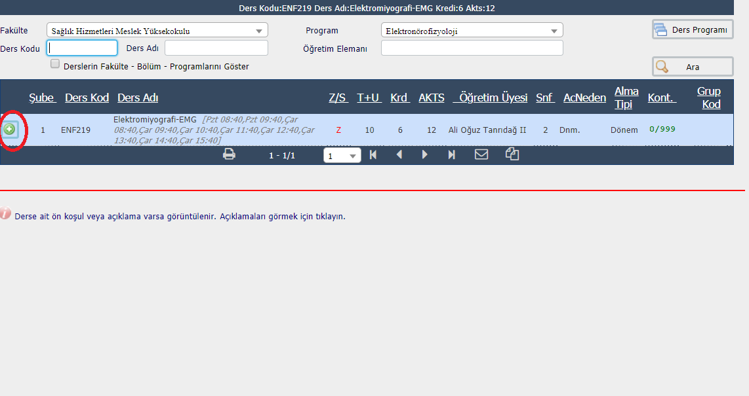
Displays if there are prerequisites or descriptions for the course. Click to see descriptions.

Slide 5
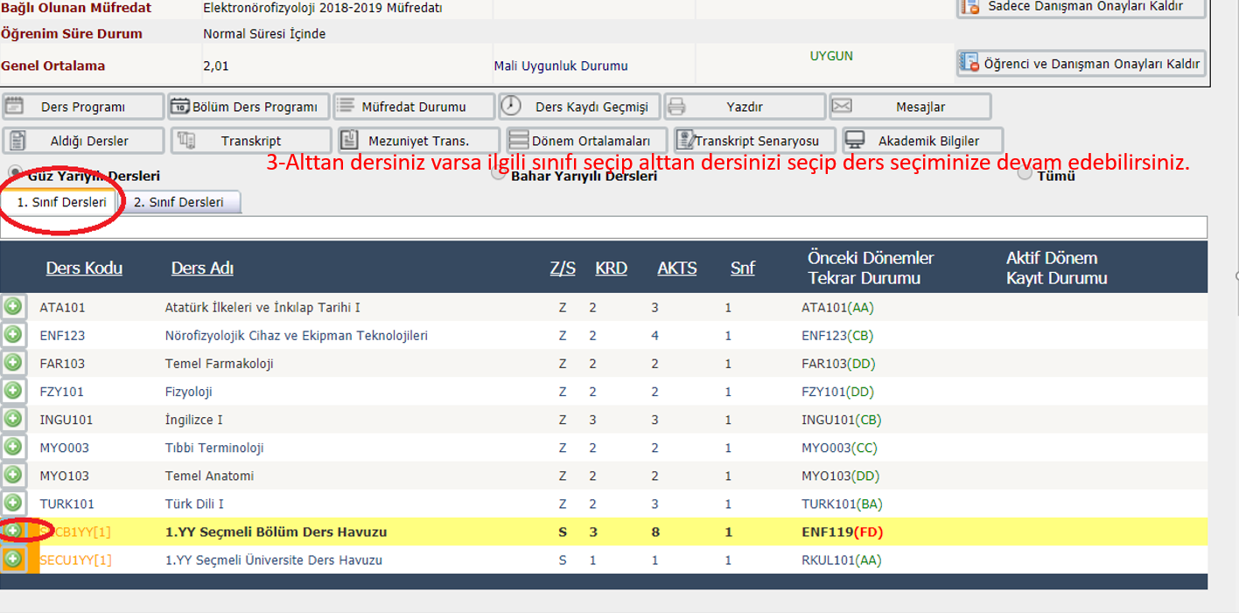
3-If you have a lower course, you can select the relevant class and continue with your course selection.
3-Alttan dersiniz varsa ilgili sınıfı seçip alttan dersinizi seçip ders seçiminize devam edebilirsiniz.

Slide 6
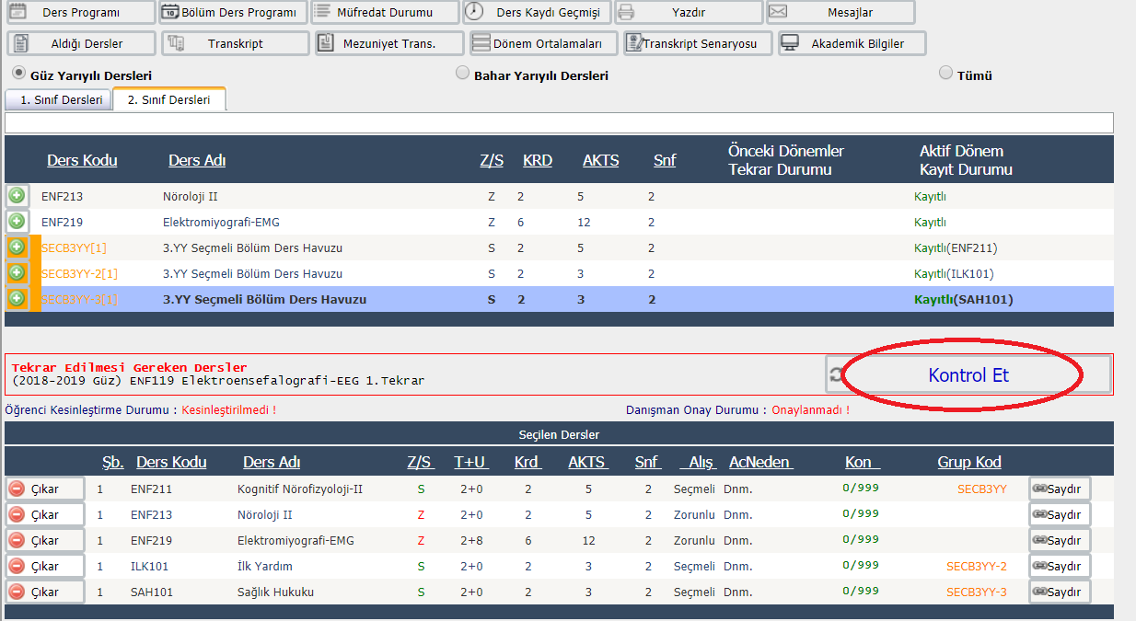
Click on <<Check>> after you have choosen all courses.
Tüm derslerinizi seçtikten sonra «kontrol ete» basınız.
Check

Slide 7
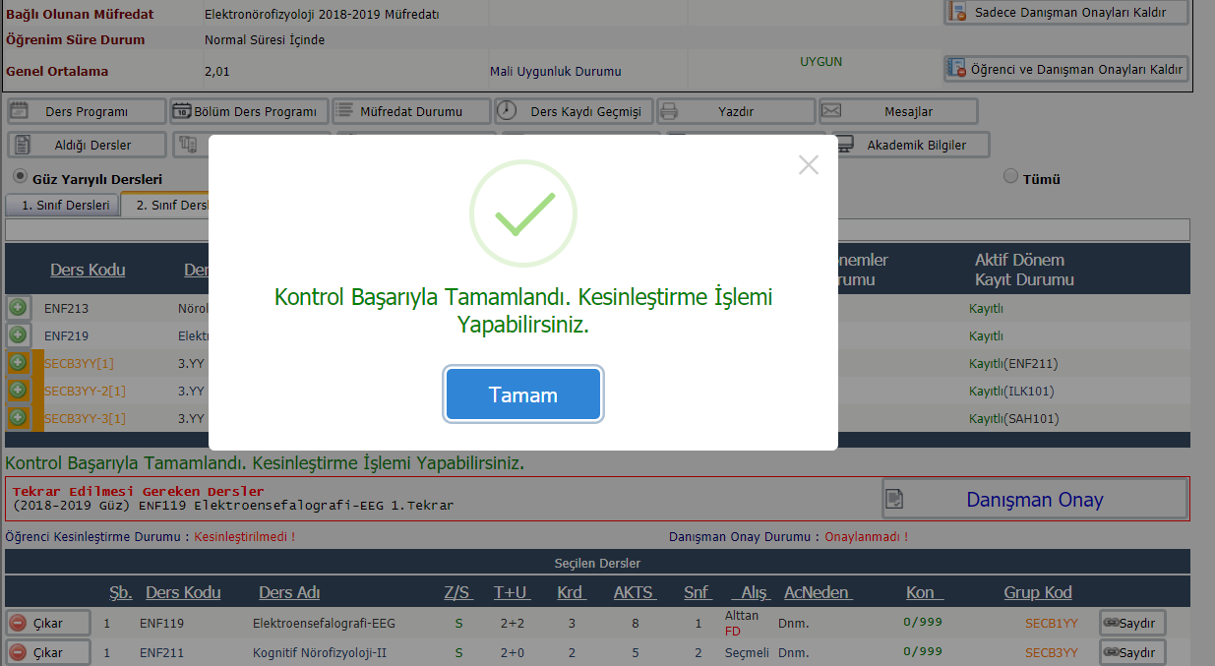
4- After checking, you will confirm your course selection by choosing finalize, and send it online to your advisor teacher for approval.
Check Completed Successfully. You Can Do The Finalization Process.
OK

Slide 8
THANKS!

